Slide 1
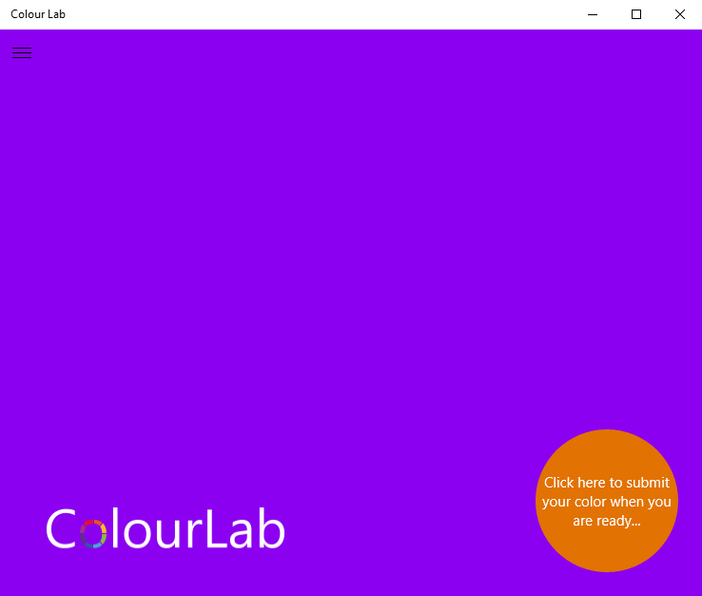
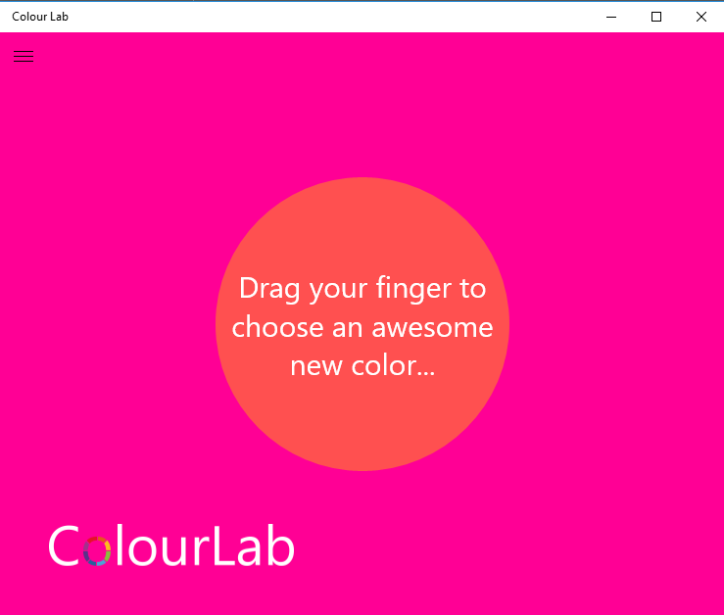
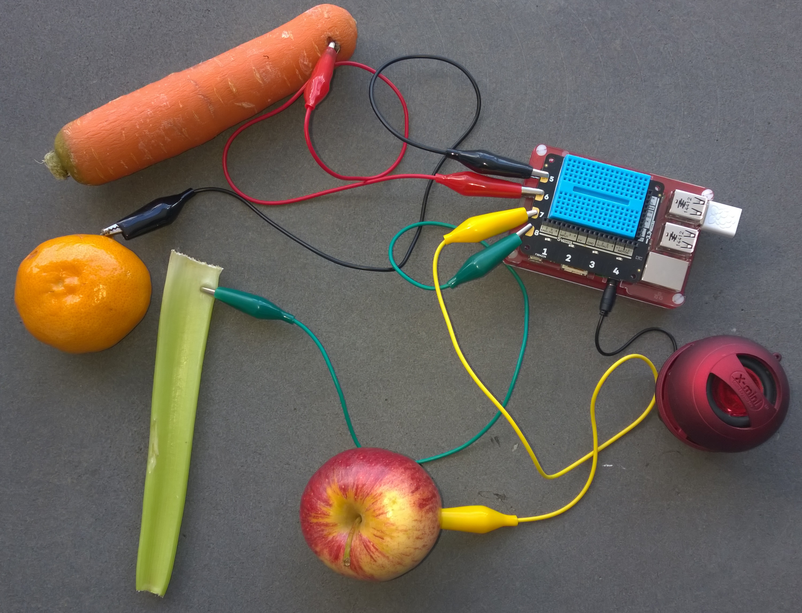
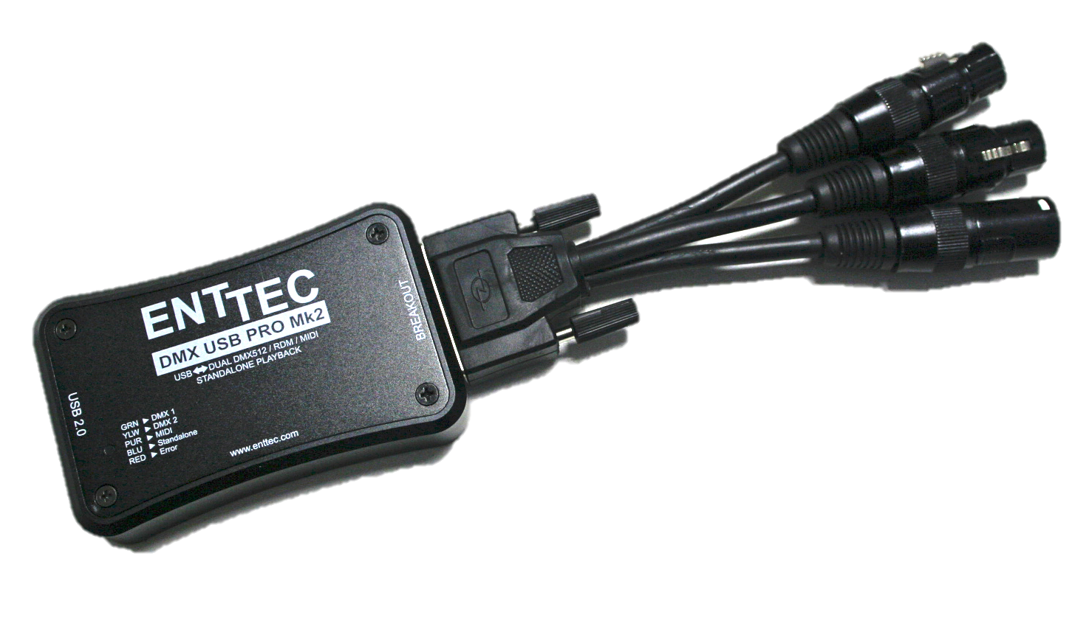
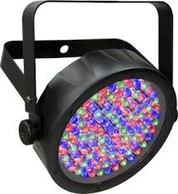
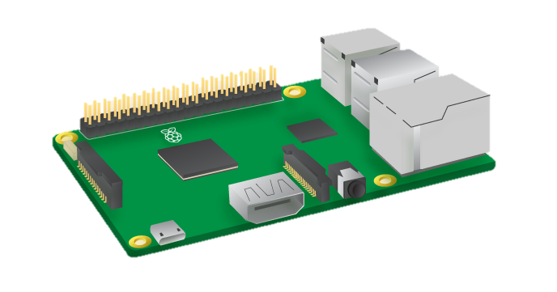
{“id”,[1,2],”red”:20,”blue”:155}
{"id":[1,2,3,4],"data":"/6T1AAAAAA=="}
{“id”,[3],”red”:255,”green”:100,”}
Fixtures.json Reference Table
MQTT BROKER
Mosquitto
Azure IoT Hub or
[
{
"desc": "LED Flat Tri 7 Light",
"id": 1,"startChannel": 1, "numberOfChannels": 7,
"initialChannelMask": [ 255, 0, 0, 0, 0, 0, 0 ],
"redChannels": [ 2 ],"greenChannels": [ 3 ],
"blueChannels": [ 4 ]
},
{
"desc": "LED Flat Tri 7 Light",
"id": 2,"startChannel": 8,"numberOfChannels": 7,
"initialChannelMask": [ 255, 0, 0, 0, 0, 0, 0 ],
"redChannels": [ 2 ],"greenChannels": [ 3 ],
"blueChannels": [ 4 ]
},
{
"desc": "LED Flat Tri 7 Light",
"id": 3,"startChannel": 16,"numberOfChannels": 7,
"initialChannelMask": [ 255, 0, 0, 0, 0, 0, 0 ],
"redChannels": [ 2 ],"greenChannels": [ 3 ],
"blueChannels": [ 4 ]
}
]
Fixture Id:1
Fixture Id:2
Fixture Id:3
.NET DMX Server
Windows or
Mono on Raspbian

